Slide 1
Kangwei Yan¹, Fei Wang^{1#} , Bo Qian¹, Han Ding¹, Jinsong Han², Xing Wei¹ 1: Xi’an Jiaotong University, Xi’an 710049, China 2: Zhejiang University, Hangzhou 310058, China {yankangwei,qb90531}@stu.xjtu.edu.cn, {feynmanw,dinghan,weixing}@xjtu.edu.cn, hanjinsong@zju.edu.cn
Person-in-WiFi 3D: End-to-End Multi-Person 3D Pose Estimation with Wi-Fi

Slide 2
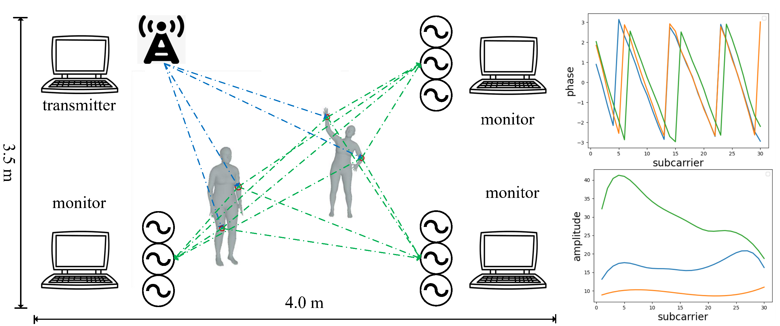
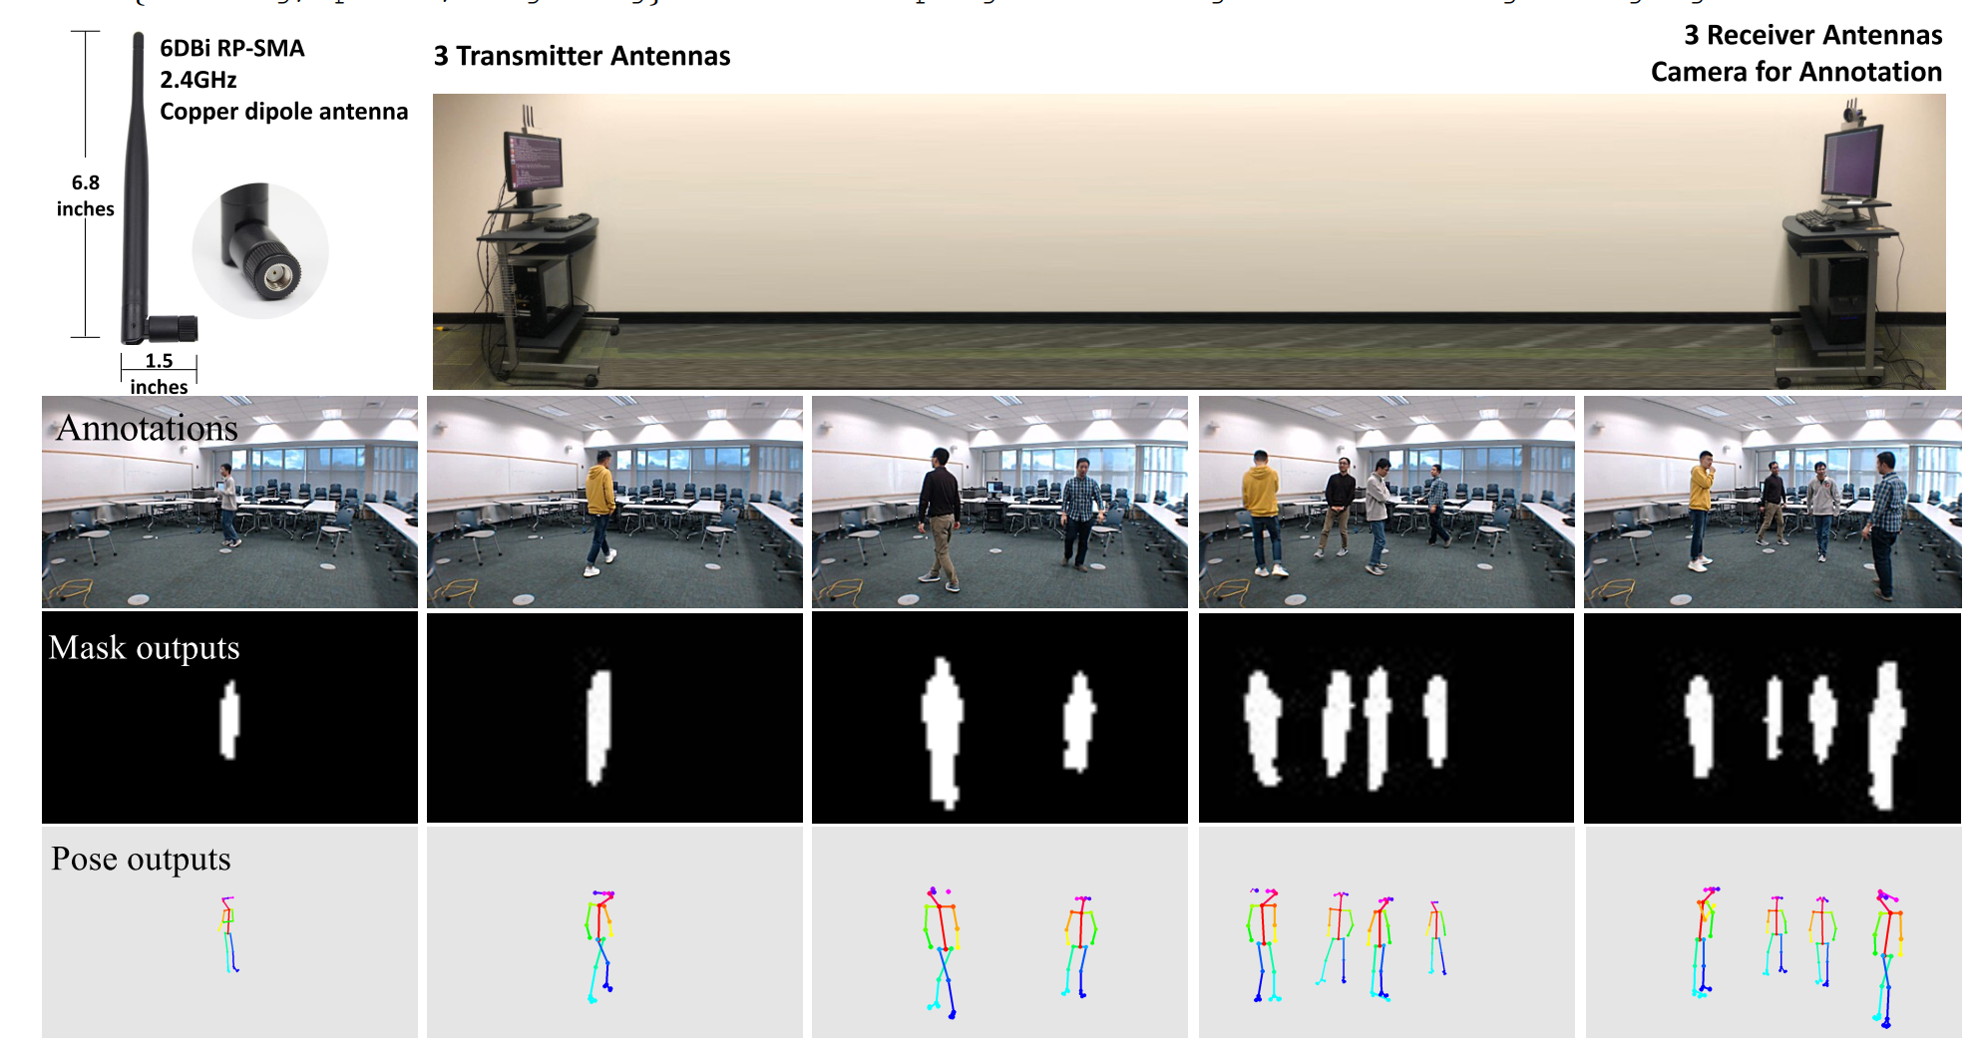
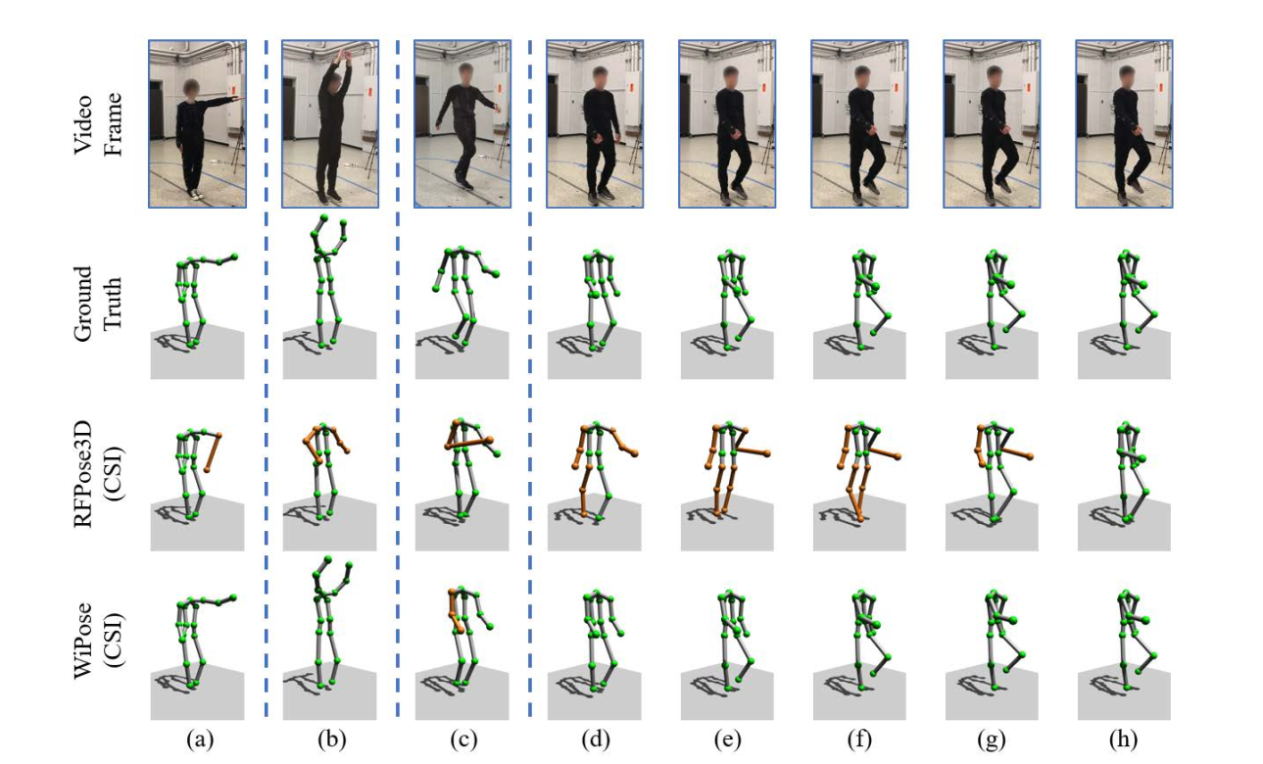
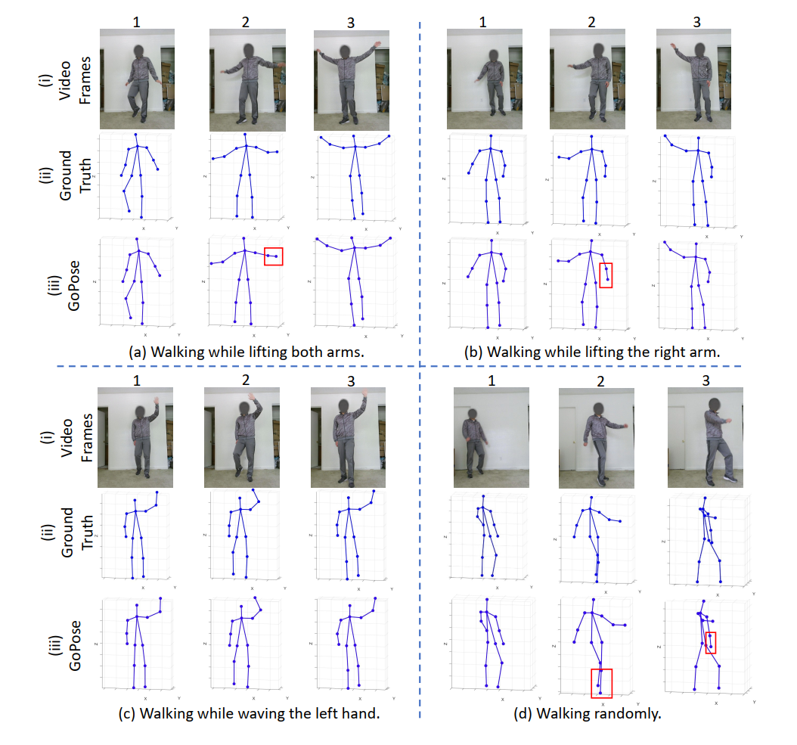
Introduction
Pose Estimation
Human-computer interaction
Action recognition
Wi-Fi based Pose Estimation:
Less privacy concern
Working in occlusion and darkness environment
Existing Work
Person-in-WiFi (ICCV 2019) ,2D multi-person
WiPose (MobiCom 2020), 3D single-person
GoPose (Ubicomp 2022), 3D single-person
No Multi-person 3D Pose -> Our Person-in-WiFi 3D
Person-in-WiFi (ICCV 2019)
WiPose (MobiCom 2020)
GoPose (Ubicomp 2022)

Slide 3
Introduction
We propose Person-in-WiFi 3D to achieve multi-person 3D pose estimation with Wi-Fi. Our work mainly includes the following contributions:
We introduce Person-in-WiFi 3D, a pioneering system designed for estimating multi-person 3D poses using Wi-Fi signals, marking a first in this area.
We develop the Wi-Fi Pose Transformer, an innovative algorithm that converts Wi-Fi signals into multi-person 3D poses in an end-to-end manner.
We comprehensively evaluate Person-in-WiFi 3D in our self-collected dataset, over 97,000 samples. Our dataset is ethically cleared for public release.

Slide 4
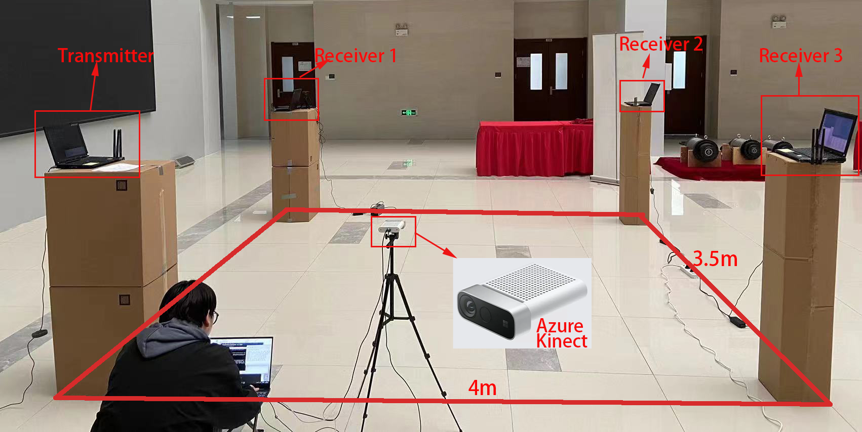
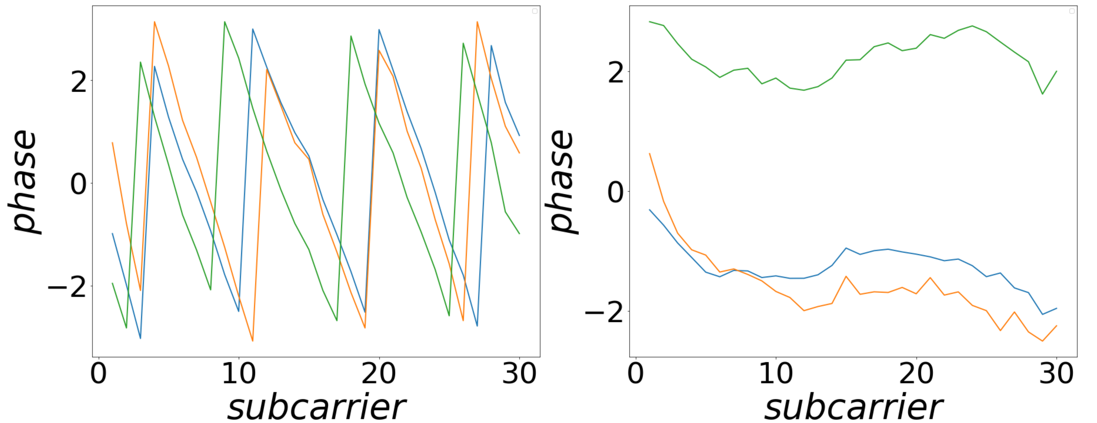
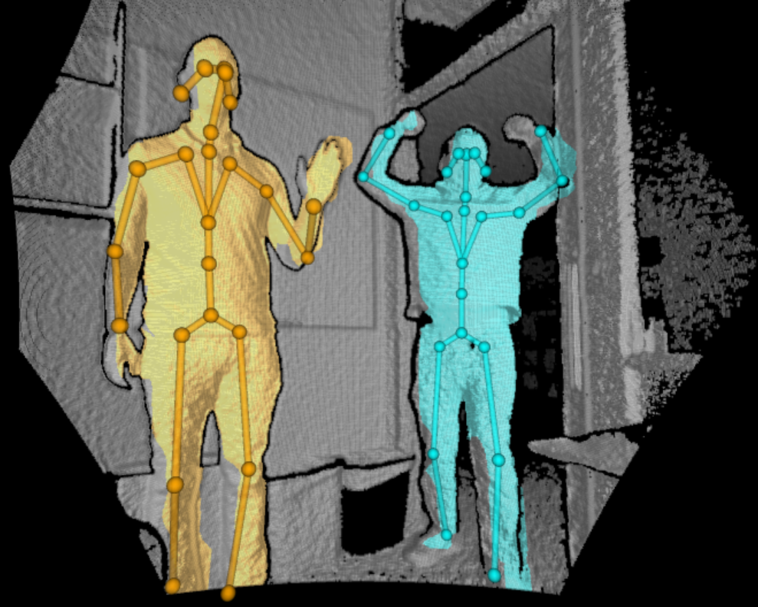
Dataset
We recruited 7 volunteers, with heights of 160-177cm and weights of 55-70kg, to perform 8 daily actions in 3 locations.
Locations :an office, a classroom, and a corridor.
Actions : reaching out, raising hands, bending over, stretching, sitting down, lifting legs, standing, and walking.

Slide 5
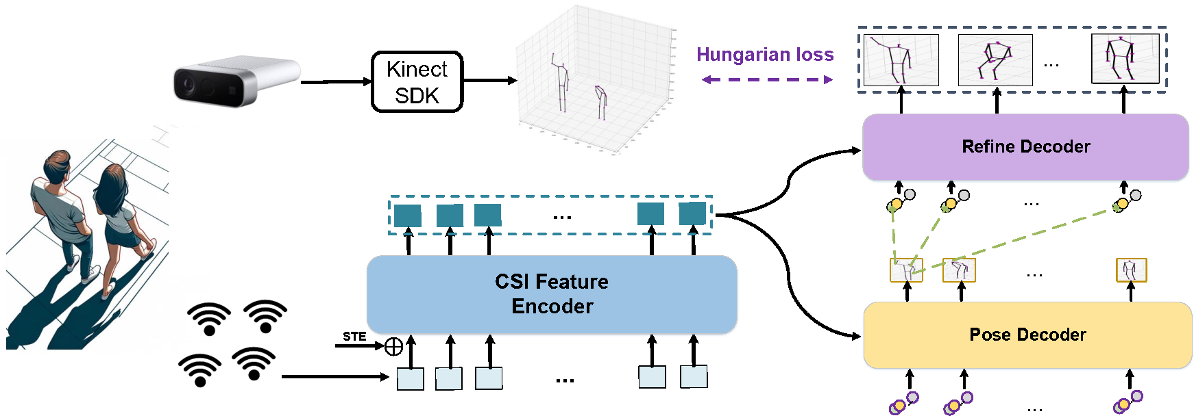
Framework
Person-in-WiFi 3D employs a teacher-student framework, where the Azure Kinect serves as the supervisory element.
The primary function of the Wi-Fi encoder and decoder within this framework is to generate 3D poses. Subsequently, the refine decoder is tasked with refining these initial outputs.
A set-based Hungarian loss is utilized after the decoder for training and inferring in an end-to-end manner.

Slide 6
Loss Function
(1) The loss includes classification loss and joint prediction error :
$$L=L_{cls}+{λL}_{kpt}$$
The focal loss function is used as the classification loss to determine the accuracy of predicting a body as a person.
$$L_{cls}=\left\{\begin{aligned} −α{(1−\hat{y})}^{γ}\log\left(\hat{y}\right) if y=1 \\ −α{\hat{y}}^{γ}\log\left(1−\hat{y}\right) otherwise\end{aligned}\right.$$
(3) L2 loss function is used to calculate the joint keypoint prediction error.
$$L_{kpt}=mean({\left\|\hat{P}−P_{gt}\right\|}_{2})$$

Slide 7
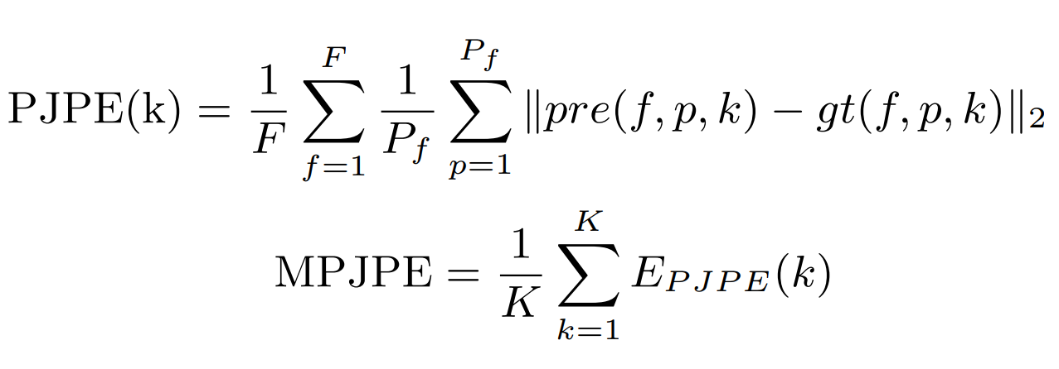
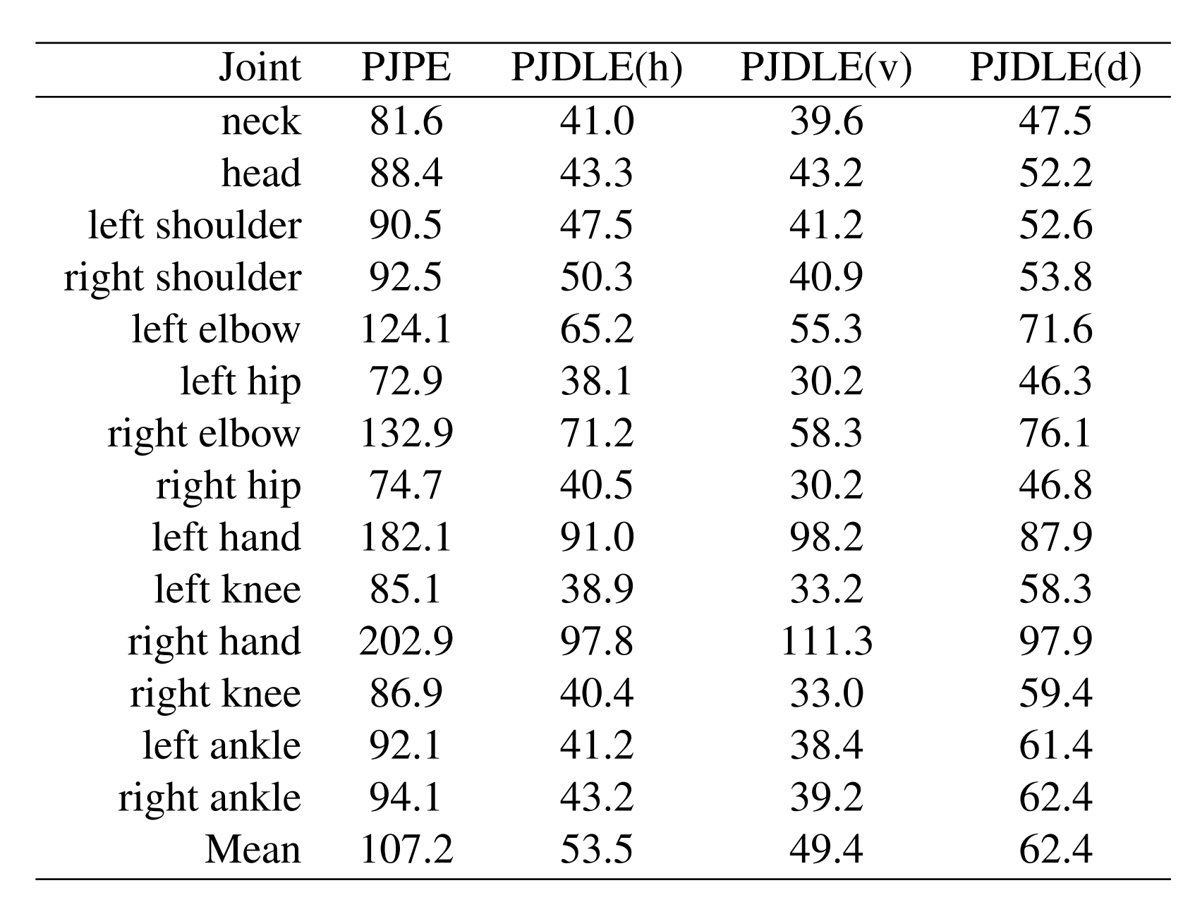
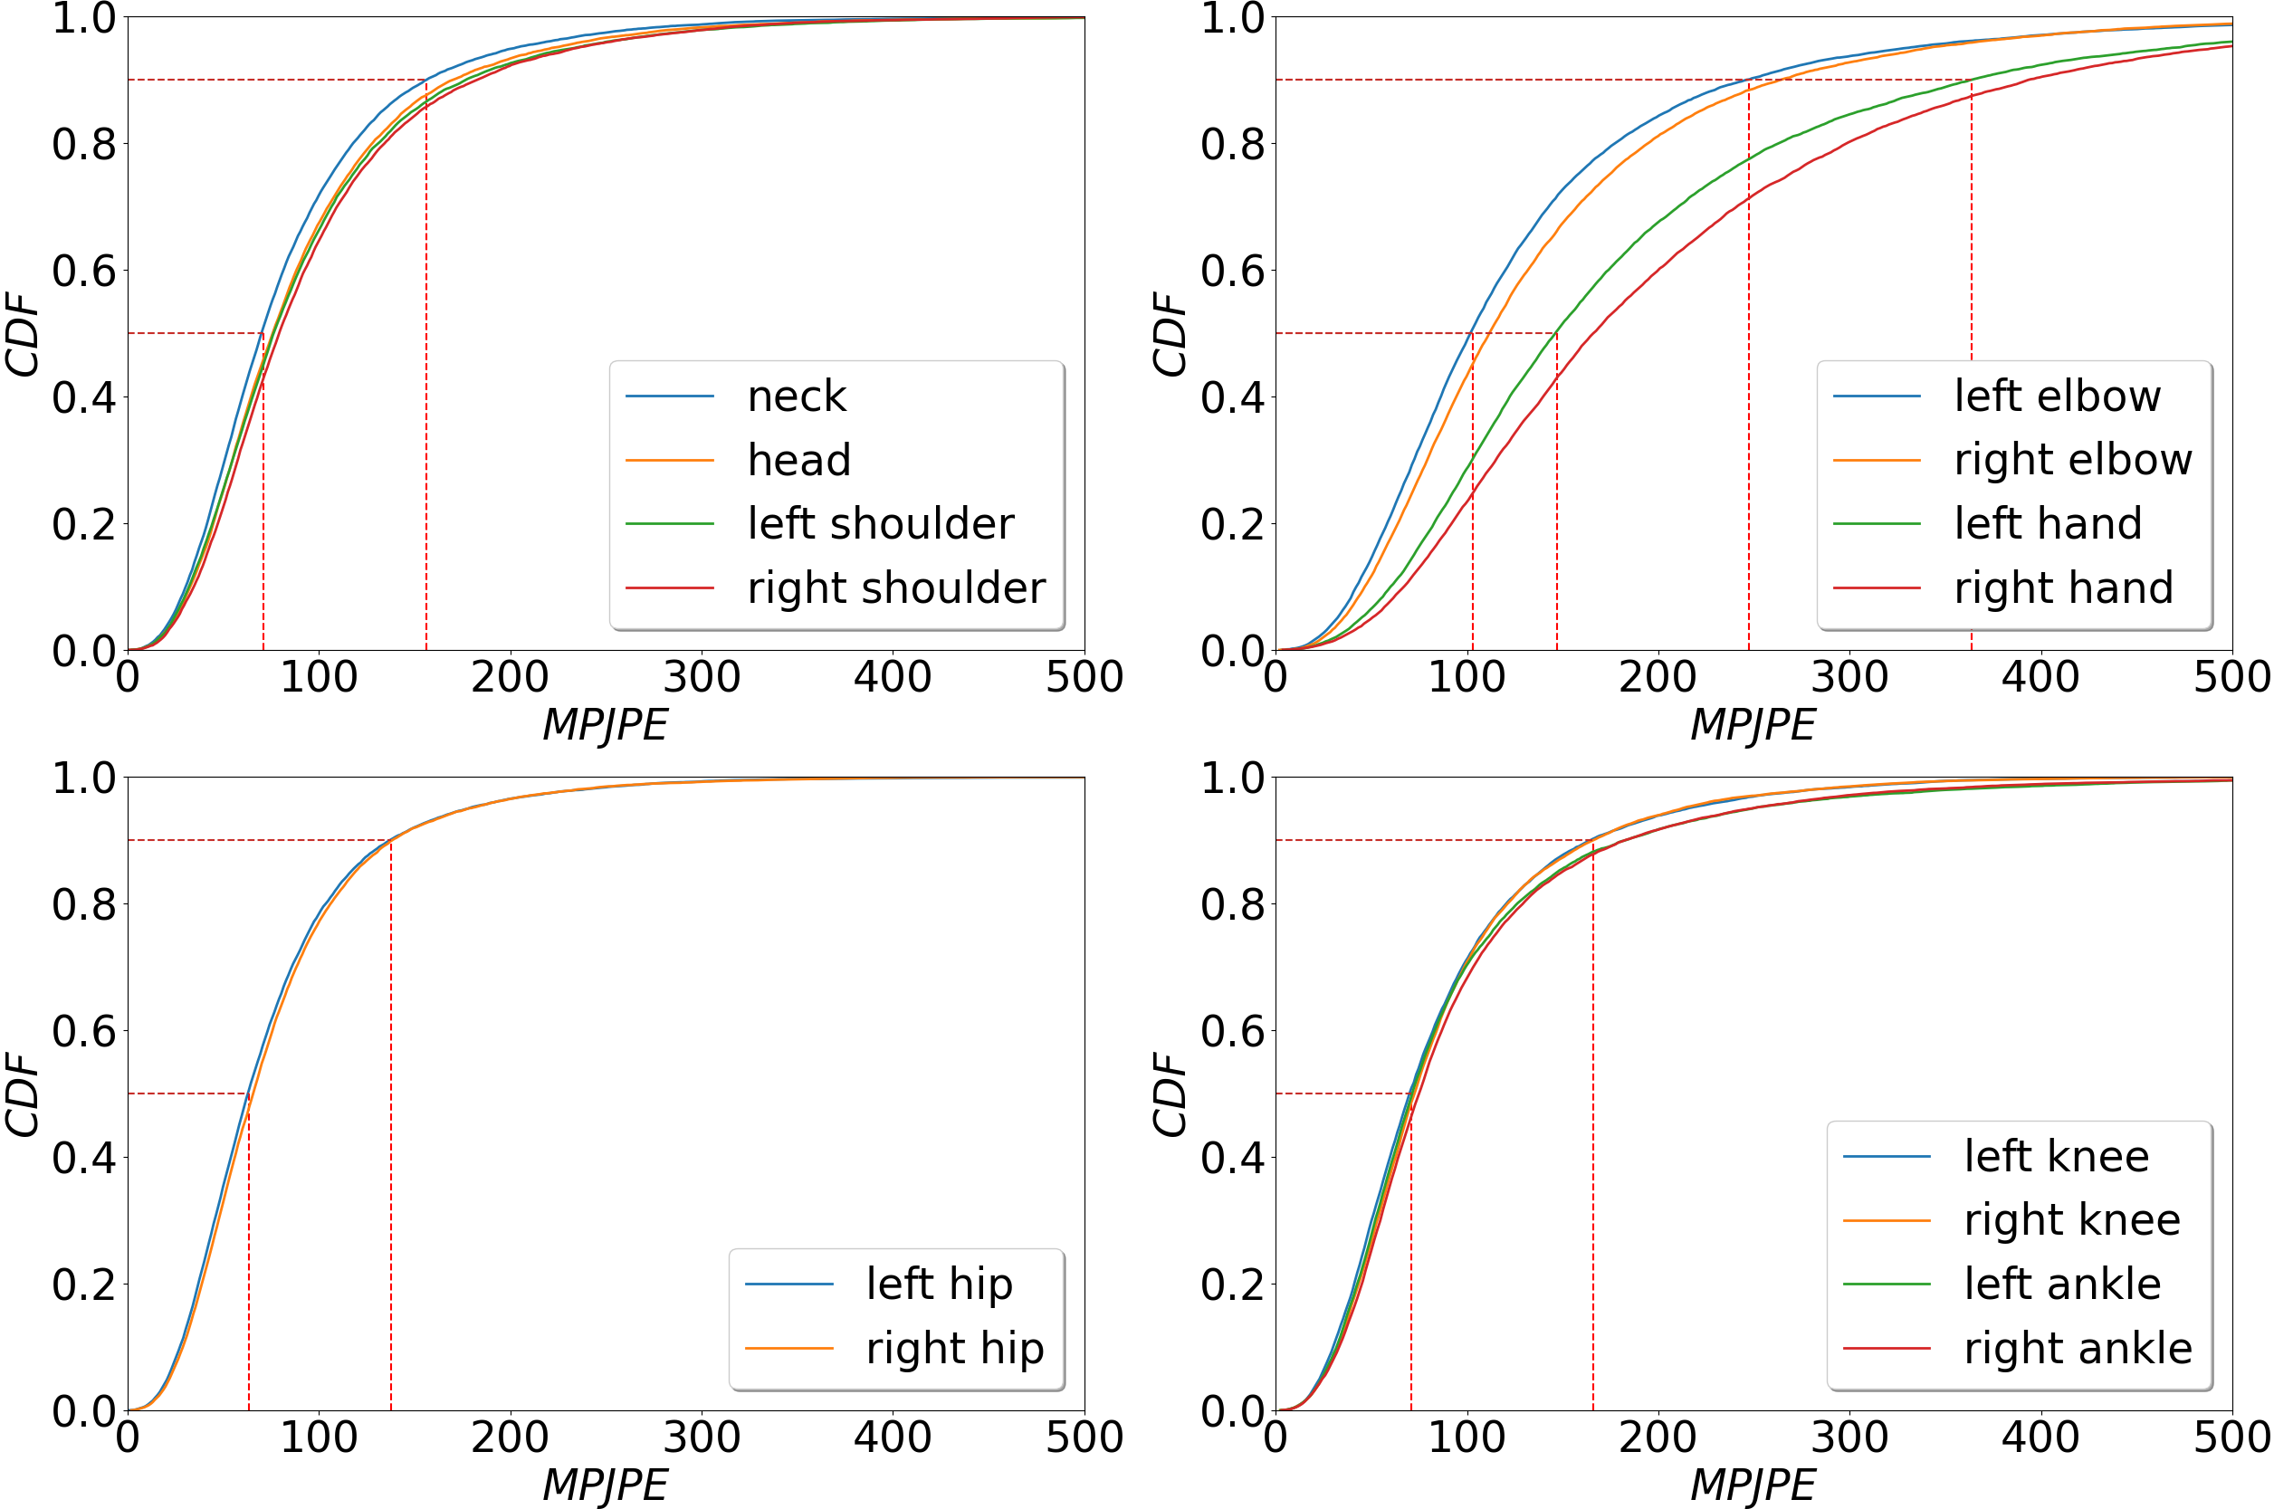
Experiment results

Slide 8
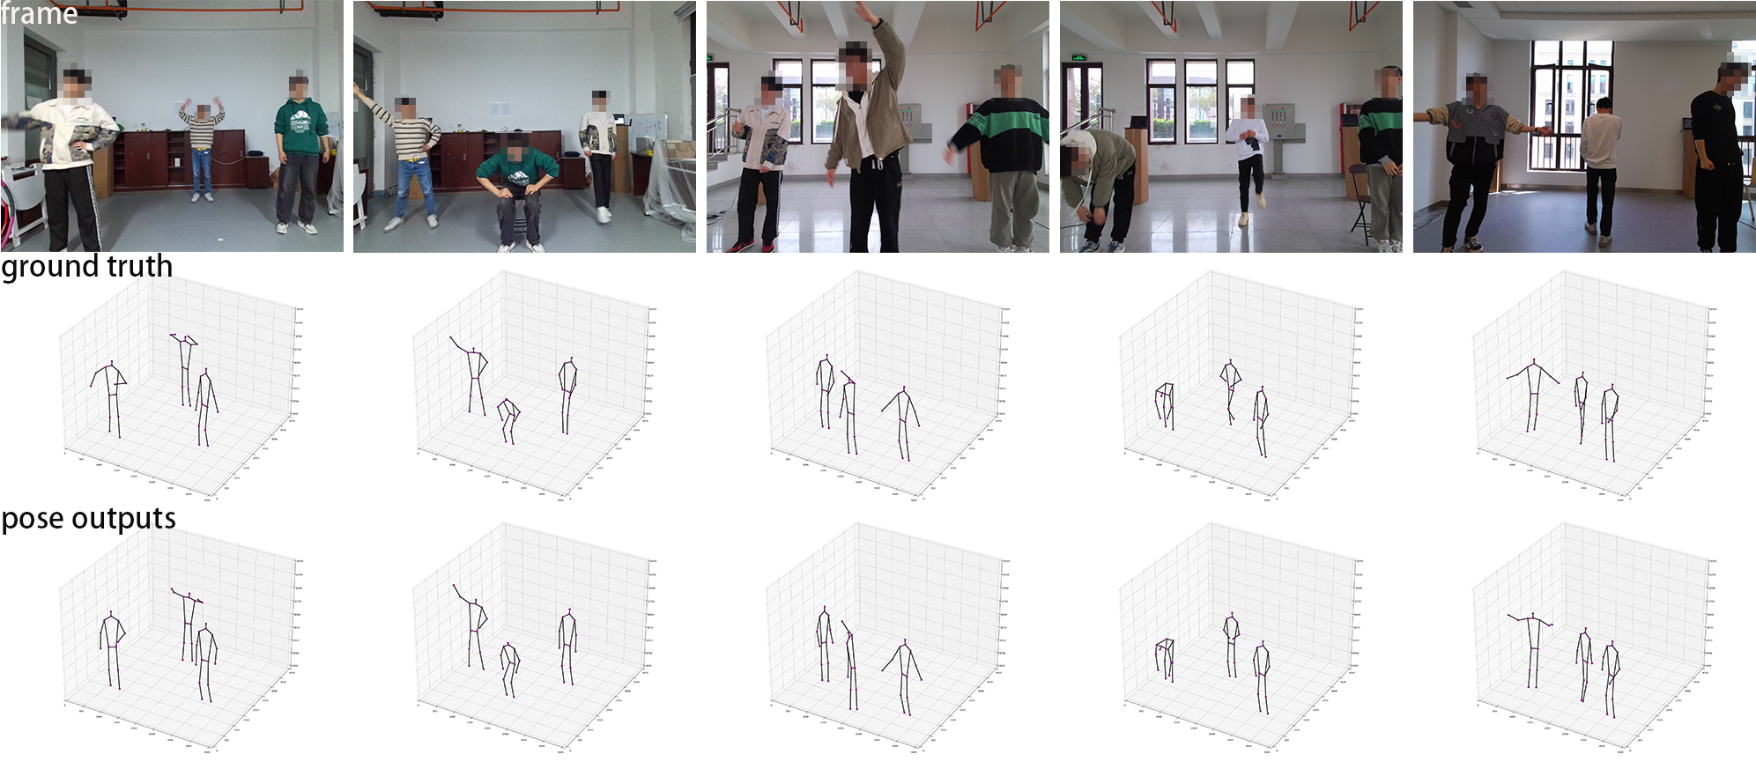
Experiment results

Slide 9
Conclusion and Discussion
Person-in-WiFi 3D, a fully end-to-end approach that addresses the multi-person 3D pose estimation task as a set-based prediction problem, elegantly achieved using a Transformer framework.
Limitations:
The upper-bound performance of Person-in-WiFi 3D is severely constrained by the Azure Kinect Body Tracking SDK. Future work could involve integrating systems such as VICON, IMUs, and optical markers for more accurate annotations.
Person-in-WiFi 3D relies on four distributed Wi-Fi transceivers. Accurately adjusting their relative spatial configurations, including positions, elevations, and antenna orientations, across different locations is challenging and necessary for ensuring cross-location generalization. Future efforts could focus on increasing the tolerance of spatial configurations to improve performance.

Slide 10
THANKS!
Code ->
kwyan1998@gmail.com

